Slide 1
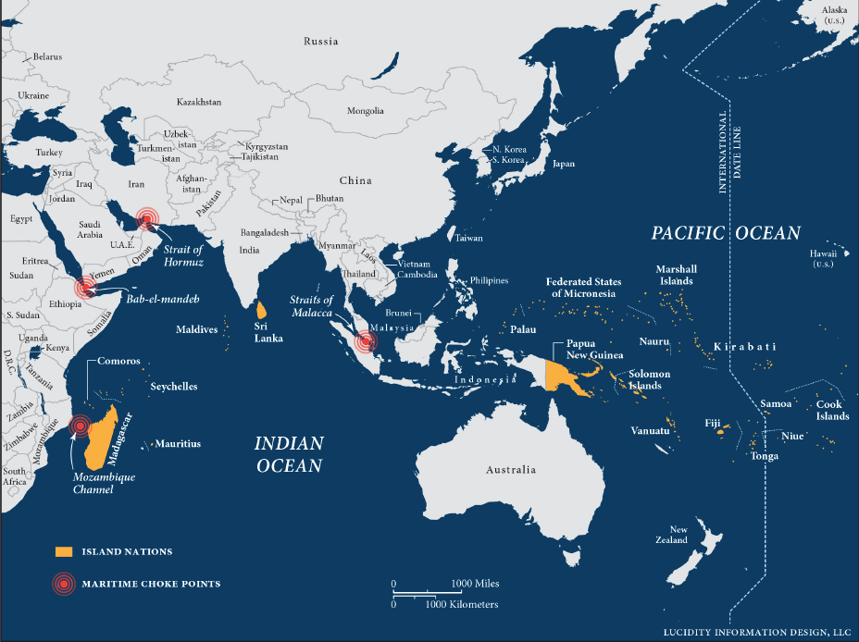

India’s Indo-Pacific Strategy: Does India need a formal approach?
Exploring Strategy, Outlook, and Policy

Slide 2



Strategy, Outlook, and Policy?
STRATEGY
POLICY
OUTLOOK/VISION
Focused, actionable plan tied to long-term national interests.
Framework guiding actions for specific goals.
Vision for engagement in a region without detailed objectives
Eg. U.S. Indo-Pacific Strategy targeting regional stability and countering China's rise.
India’s Act East Policy focuses on economic ties with Southeast Asia.
Japan’s Free and Open Indo-Pacific Outlook prioritises inclusivity.
Why do these terms matter? Aligning terminology with intent avoids confusion in global diplomacy.

Slide 3
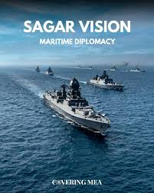
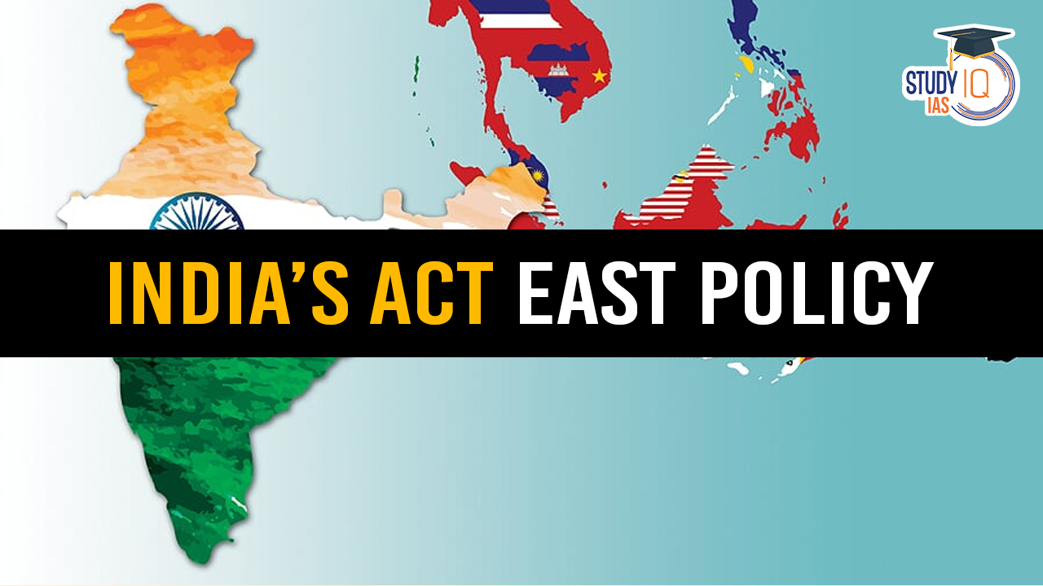
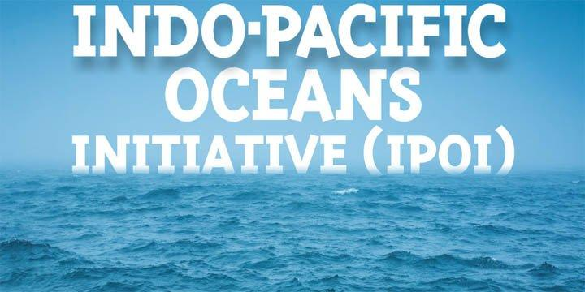
India’s current approach to the Indo-Pacific
Exploring India's Evolving Role and Strategic Initiatives
Aimed at strengthening ties with Southeast Asian nations.
Focus on economic integration and connectivity projects.
Collaboration with ASEAN on trade and cultural exchanges.
Infrastructure development in the Northeast region as a gateway to Southeast Asia.
Partnerships with Japan and South Korea to promote a free and open regional order.
"Security and Growth for All in the Region" (SAGAR) focuses on maritime security.
Promotes regional collaboration in the Indian Ocean.
Advocates sustainable development through maritime cooperation.
Enhances India’s role as a net security provider in the region.
Addresses non-traditional threats like piracy and illegal fishing.
Seven pillars include Maritime Security, Ecology, and Resource Sharing.
Disaster Risk Reduction and Management is a key focus.
Launched to complement ASEAN’s Indo-Pacific vision.
Encourages capacity building in science, technology, and academic cooperation.
Supports sustainable trade and connectivity in maritime transport.

Slide 4
INDO-PACIFIC DYNAMICS
FACTORS DRIVING INDIA'S EMBRACE OF THE INDO-PACIFIC
Key Influences and Strategic Shifts
Initial Hesitation
India was initially hesitant to embrace the Indo-Pacific concept due to historical and strategic
factors, focusing primarily on its own interests in the Indian Ocean.
China's Influence
China's growing economic and political presence in South Asia, especially through the Belt
and Road Initiative, prompted India to reassess its regional strategy to maintain its influence.
Border Tensions
Escalating border tensions with China, notably the 2020 Galwan Valley clash, significantly
shifted India's strategy towards enhancing military capabilities and external partnerships.
Strategic Partnerships
India's strengthening defence ties with the US and participation in frameworks like the Quad reflect its commitment to balancing strategic interests in the Indo-Pacific.
Maintaining Autonomy
While engaging with Western allies, India aims to preserve its strategic autonomy, carefully navigating relationships to avoid alignment that might provoke China.

Slide 5
Recommendations
Importance of India-Japan partnership
Economic integration with ASEAN
Recent trade agreements – Australia and UAE
Mini-lateral initiatives like India-Japan-Australia
Forums like ASEAN and IORA
STRATEGIC PARTNERSHIPS AND MINILATERALS
Addressing non-traditional security challenges
Inter-Agency Coordination
Coast Guard and UN Goals
Integration of SAGAR with Sagarmala
National Maritime Security Coordinator
STRATEGIC BASES AND MARITIME SECURITY
Sagarmala Initiative
Bharat Mala Initiatives
India-Japan Act East Forum
ASEAN and Regional Trade
Shipbuilding Policy
ECONOMIC CONNECTIVITY

Slide 6
Future Opportunities in the Indian Ocean Region
INDIA'S RESPONSE TO CHINA'S ACTIVITIES IN THE IOR
ROLE AS A REGIONAL FIRST RESPONDER
India has actively engaged in disaster relief and anti-piracy operations, showcasing its commitment to regional security.
Increased naval operations and strategic base establishment in the Indian Ocean Region to counterbalance China’s influence.
MISSION-BASED DEPLOYMENTS AND CONTINUOUS PRESENCE
Maintaining a continuous naval presence at strategic entry points ensures readiness and rapid response capabilities.
ESTABLISHMENT OF NEW STRATEGIC BASES: INS JATAYU AND INS KADAMBA
BOLSTERED NAVAL OPERATIONS SINCE 2018
The Indian Navy has undertaken mission-based deployments to ensure a constant presence and readiness in key maritime areas since 2018.
The establishment of bases such as INS Jatayu and INS Kadamba has improved India’s operational reach and capabilities in the region.

Slide 7
Thank you
Special thanks to Dr Pooja Bhatt and Captain Sarabjeet Parmar for their valuable inputs on this paper.
The Paper is available at: https://cuts-global.org/indo-pacific-forum.htm
Researched by Mihir S Bhonsale and Dhruv Bansal, CUTS International

