Slide 1

Rethinking Africa's Approach to New Trade Agreements
and WTO Reform
David Luke & Hana AlWakeel
Firoz Lalji Institute for Africa, LSE

Slide 2
01
Background and
Main Questions

Slide 3
WHY NOW?
THREE QUESTIONS
Africa is the last bastion of extreme poverty.
60% of those living in extreme poverty are in Africa.
Africa’s share of global trade accounts for < 3%
Food insecurity
42% of African countries are net food importers
Changing global context:
  Fragile multilateral trading system
  Unilateral trade measures (CBAM, US Tariffs)
  Geopolitical rivalries
  Dual transition
01
What kind of trade agreements does Africa need from its global partners to achieve its developmental objectives?
02
How should this align with WTO reform?
03
What internal trade reforms are essential for Africa’s economic transformation?

Slide 4
02
Africa’s Trade Landscape
3 Key Trends

Slide 5
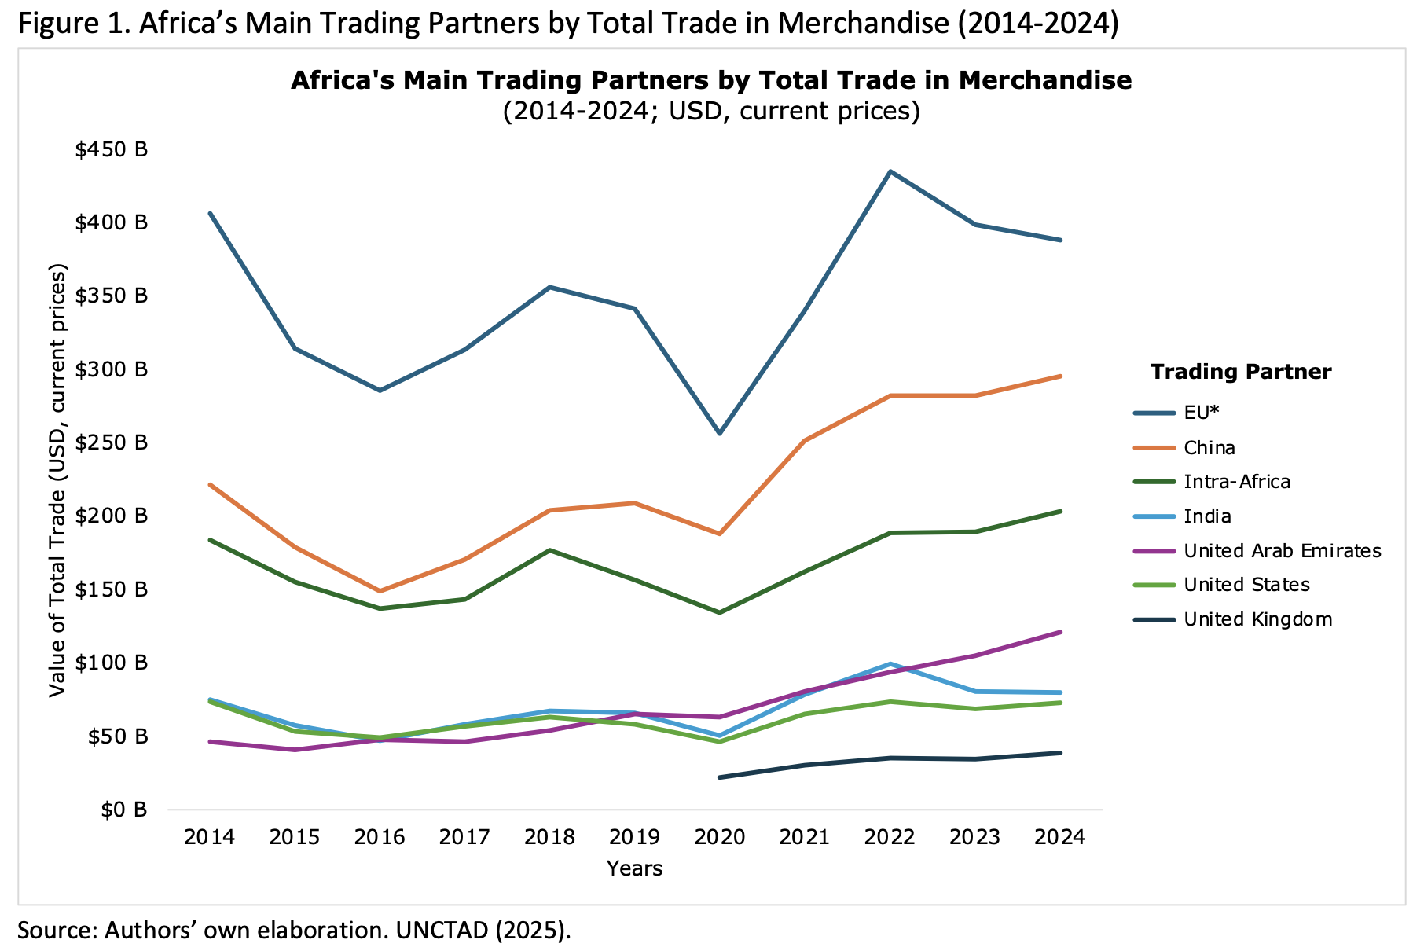
1.
Africa's changing trade patterns
The EU bloc and China are the continent’s largest trade partners
India and the United Arab Emirates have intensified their engagement with Africa surpassing the US
Intra-African trade is expanding rapidly, reflecting growing regional integration
Source: UNCTAD 2025 | Authors' own elaboration

Slide 6
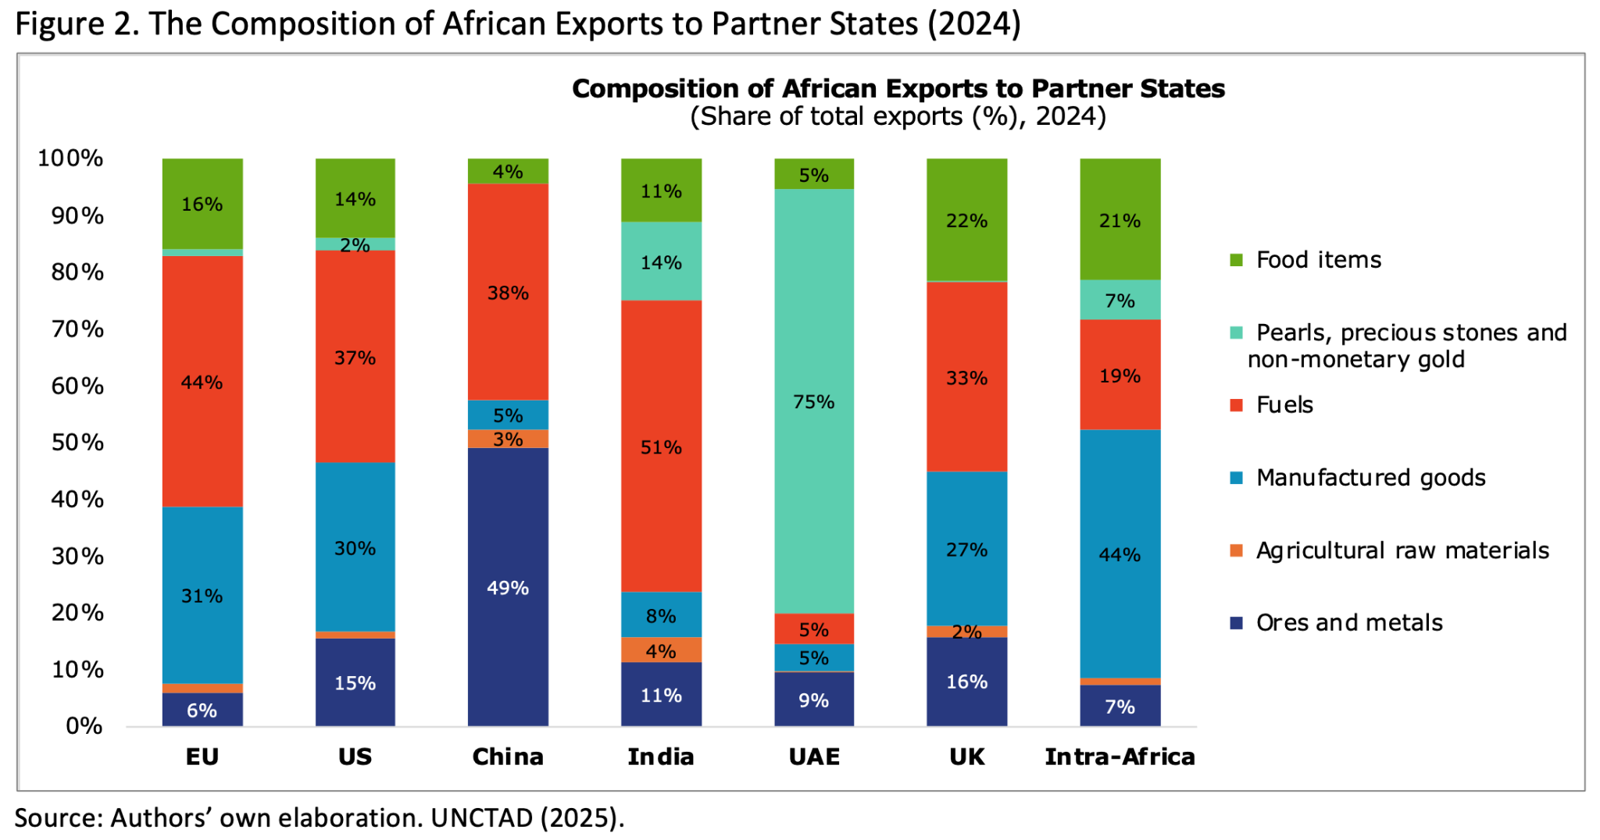
2.
Intra-African trade is more diversified
While most exports are concentrated in primary commodities (fuels, precious stones/ minerals and metals), intra-African trade has a more diversified mix of value-added manufactured goods. This should not be an exception.
Source: UNCTAD 2025 | Authors' own elaboration

Slide 7
3.
Africa’s trade future will depend on
long-term competitiveness, not just market access
3 Elements of Building Competitiveness
Adaptability. Strong export performance in US market post-tariffs have proved Africa’s export resilience.
Exports to the US, particularly textiles and apparels from East Africa, proved more resilient than anticipated in the face of the Trump tariffs and continued to grow in 2026.
This is possible due to a) delays in tariff enforcement and b) African exporters’ adaptability.
Productive Capacity. Investments in sectors that enhance productive capacity will be crucial to enable African firms to operate at scale and integrate in regional and global value chains
Green windows of opportunity. African countries cannot build competitiveness in the current global landscape without green industrialization.
African countries possess the resource endowments (‘critical’ minerals and natural resources) to situate them at the center of the green transition.
However, whether they are active competitors or passive late-comers will depend on preserving and expanding the green industrial policy space.

Slide 8
03
A New Approach to Trade Agreements

Slide 9
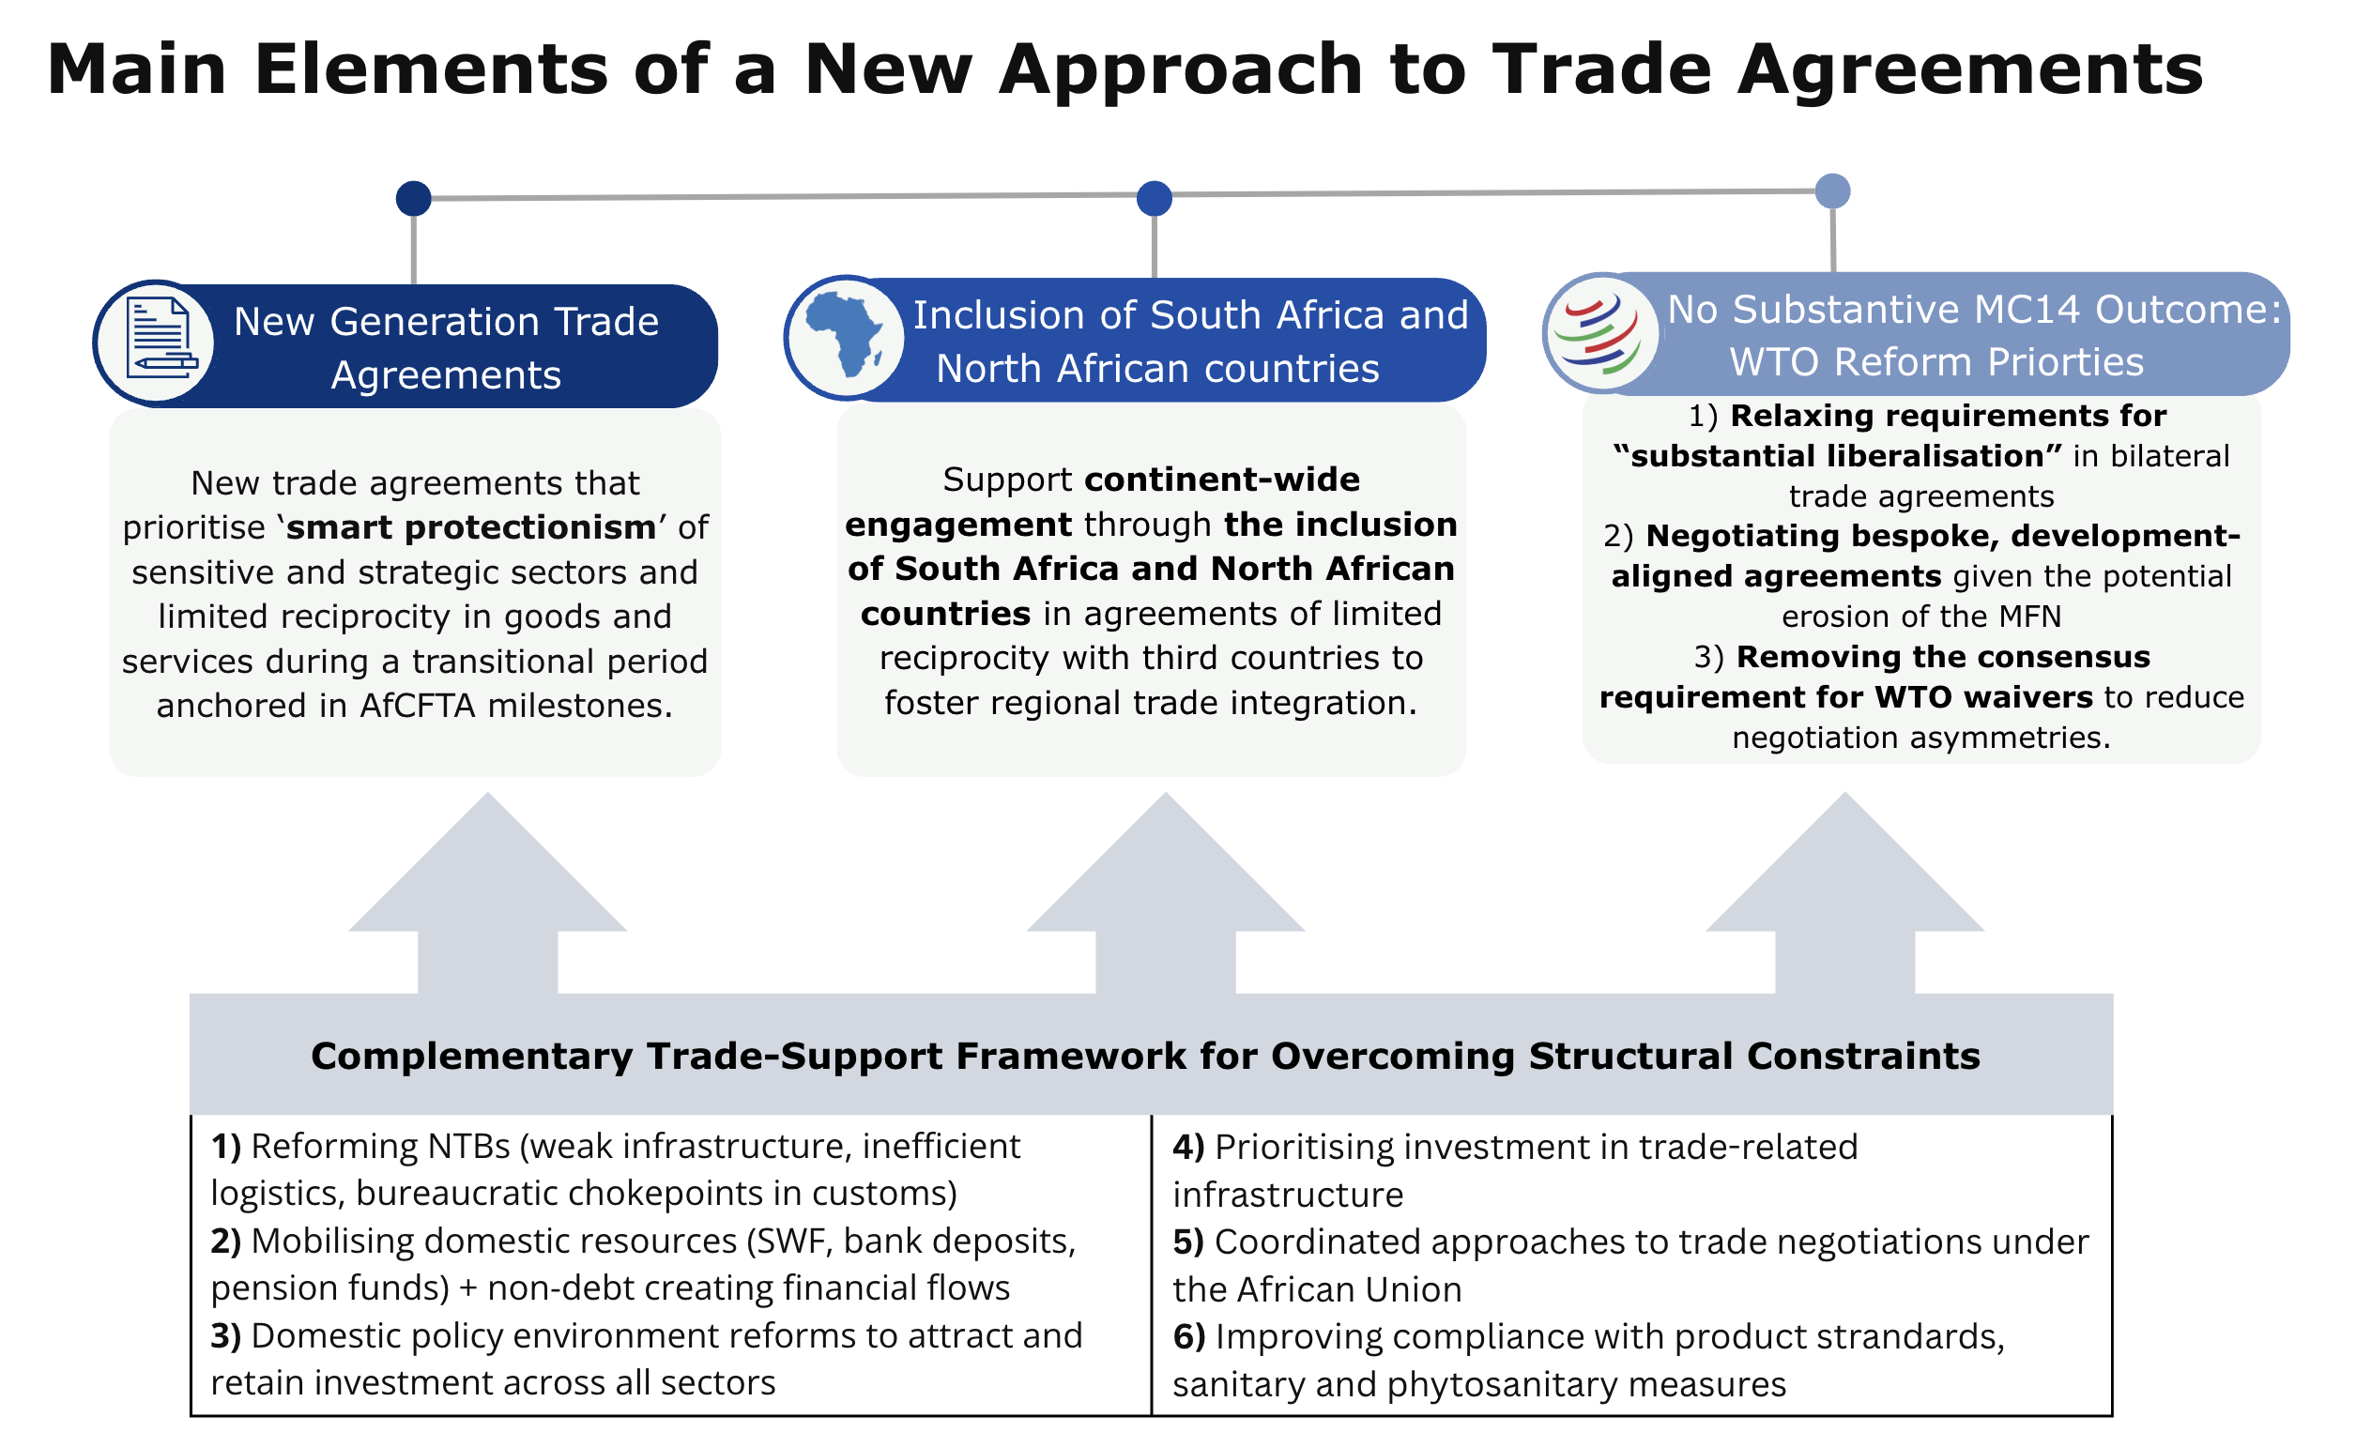
Main Elements of a New Approach to Trade

Slide 10
A Trade Support Framework
The role of Africa’s trade and development partners
Africa’s Internal ‘Behind the Border’ Reforms
01
More and better quality investments
- A deliberate shift away from extraction to value-added sectors (agri-processing, manufacturing, services, etc.)
Capacity building and technical assistance support
Aligning ODA with trade reforms
Strengthening South-South partnerships
Strengthening competition policy, deepening financial sectors and creating clear regulatory frameworks
02
SME technical and financial support, compliance with product standards and phytosanitary measures; improved access to finance
03
Facilitating movement of people - visa restrictions impedes opportunities for commercial relations between African businesses

Slide 11
Rethinking Africa’s trade future does not rely on preference-based approaches alone, but on the ability to attract investments, building industrial capacities, and securing a supportive external trade regime.
Key Takeaway

Slide 12
Thank you!

